Slide 1

Sequence to sequence models
Basic models
deeplearning.ai

Slide 2








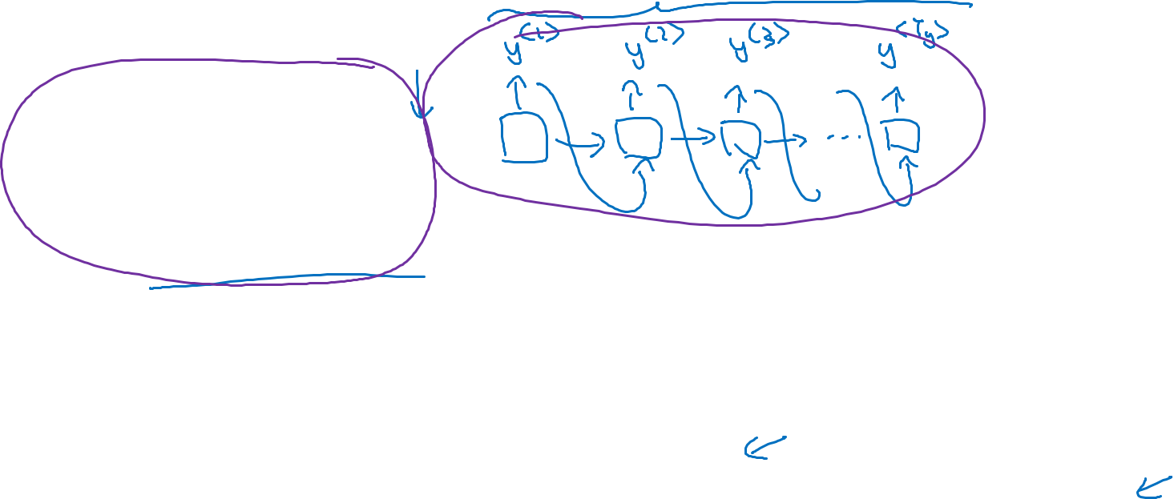







Sequence to sequence model
$$x^{<1>}$$
$$x^{<2>}$$
$$x^{<3>}$$
$$x^{<4>}$$
$$x^{<5>}$$
Jane visite l’Afrique en septembre
Jane is visiting Africa in September.
$$y^{<1>}$$
$$y^{<2>}$$
$$y^{<3>}$$
$$y^{<4>}$$
$$y^{<5>}$$
$$y^{<6>}$$
$$a^{<0>}$$
$$⋯$$
$$x^{<1>}$$
$$x^{<T_{x}>}$$
This is RNN like GRU or LSTM
[Sutskever et al., 2014. Sequence to sequence learning with neural networks]
[Cho et al., 2014. Learning phrase representations using RNN encoder-decoder for statistical machine translation]

Slide 3




























Image captioning
$$y^{<1>}$$
$$y^{<2>}$$
$$y^{<3>}$$
$$y^{<4>}$$
$$y^{<5>}$$
$$y^{<6>}$$
A cat sitting on a chair
MAX-POOL
MAX-POOL
11$×$ 11
s = 4
3$×$ 3
s = 2
5$×$ 5
same
3$×$ 3
s = 2
3$×$ 3
same
3$×$ 3
55$×$55 $×9$6
27$×$27 $×$96
27$×$27 $×$256
13$×$13 $×$256
13$×$13 $×$384
MAX-POOL
=
3$×$ 3
3$×$ 3
s = 2
$$⋮$$
$$⋮$$
$$⋮$$
Softmax
1000
13$×$13 $×$384
13$×$13 $×$256
6$×$6 $×$256
9216
4096
4096
$${\hat{y}}^{<1>}$$
$${\hat{y}}^{<2>}$$
$${\hat{y}}^{<T_{y}>}$$
$$⋯$$
$$x$$
[Mao et. al., 2014. Deep captioning with multimodal recurrent neural networks]
[Vinyals et. al., 2014. Show and tell: Neural image caption generator]
[Karpathy and Li, 2015. Deep visual-semantic alignments for generating image descriptions]

